Slide 1

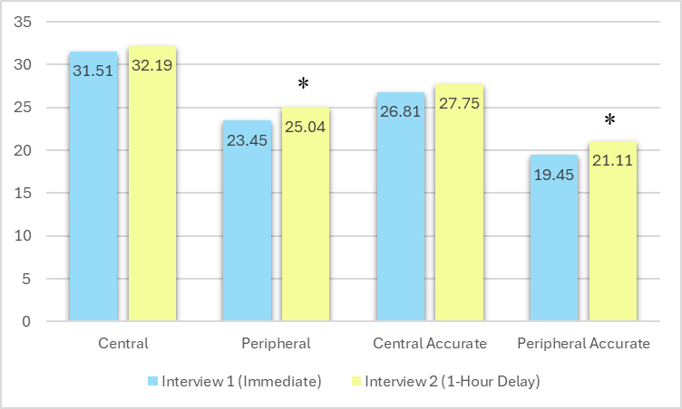
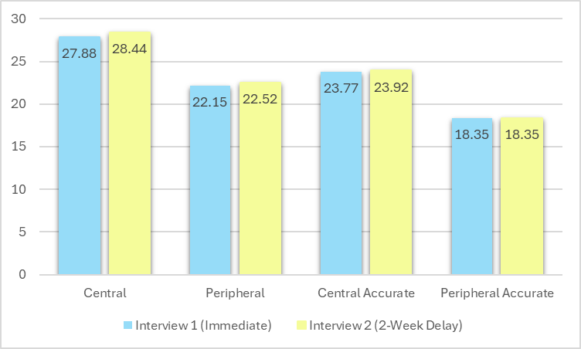
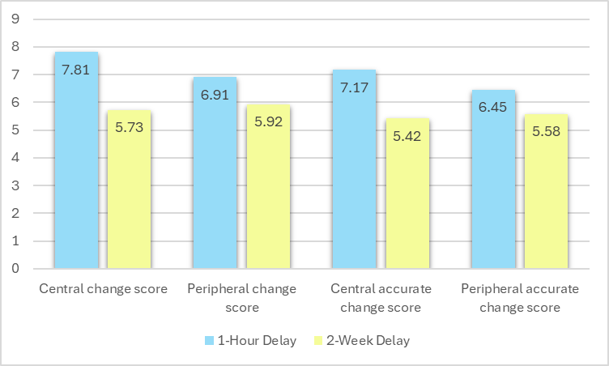
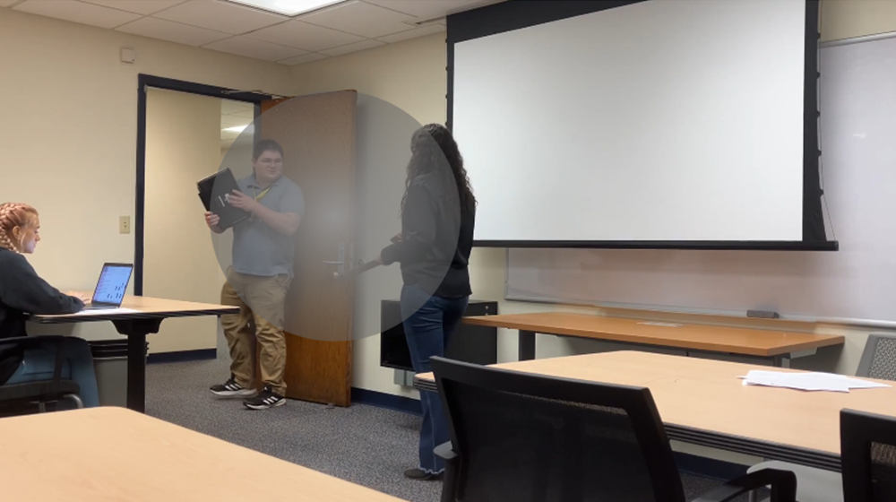
Recall of central details and accuracy remained stable across time periods. Recall of peripheral details and accuracy increased after a short delay
The Impact of Delay on Central and Peripheral
Details in Eyewitness Reports
Authors
Athena Filias, Haley R. Dawson, PhD, Nadja Schreiber Compo, PhD
INTRODUCTION
Memory can decay or become contaminated over time, making immediate interviews crucial for investigation. Since that is not always possible, it is import to understand what happens to information when recalled over different time periods.
Most research emphasizes quantity over quality in eyewitness memory, with no standard definition for central or peripheral details.
This study integrates foveal attention and legal psychology to define them visually:
- Central: details appear in the immediate foreground
- Peripheral: details are background elements
Goal: examine how central and peripheral details are recalled and retained over time.
METHODS
Utilized Data from Dawson & Schreiber Compo (2025)
  Participant recall of a mock crime
  Answered open-ended and cued questions at two time points:
    immediate & 1-hour delay
    immediate & 2-week delay
Responses were coded into: central/peripheral details accuracy, and change scores.
SPSS analyses included:
  Two paired samples t-tests to compare recall across delays.
  Four independent samples t-tests to analyze change scores and accuracy between central and peripheral details.
DEMOGRAPHICS
105 undergraduate FIU students
  Primarily White (71%), Hispanic (74%), and Female (79%)
HYPOTHESES
H1: There will be a stronger effect of delay on peripheral details than central details (x)
H2: There will be a stronger effect of delay on accurate peripheral details than accurate central details (x)
H3: there will be more central details recalled after a 1-hour delay compared to a 2-week delay (x)
H4: there will be less peripheral details recalled after a 2-week delay than 1-hour (x)
RESULTS
None of the hypotheses were supported. Findings suggest short-term retrieval enhanced peripheral recall and accuracy, while central details remained unchanged.
H1&H2: peripheral details and accurate peripheral details increased after a 1-hour delay, while central details remained unchanged. No significant differences were found after a 2-week delay.
H3&H4: recall of central and peripheral details remained stable over time
LIMITATIONS
Subjective definition of central and peripheral details may have skewed results.
The tightly focused mock crime video provided limited peripheral details for recall.
There was a ceiling effect on overall accuracy rates (M = 87%)
Immediate vs 1-Hour Delay on Recall of Crime Details
Immediate vs 2-week Delay on Recall of Crime Details
Mean Change in Details Recalled
M = 3.12
Mean Change in Details Recalled
M =7.67
Central vs. Peripheral Recall & Accuracy Change Scores
Central Ring Visual Demonstration
M = 25.3%
Mean Change in Details Recalled
M = 14.0%

